Slide 1
Plotting contingency tables

Slide 2
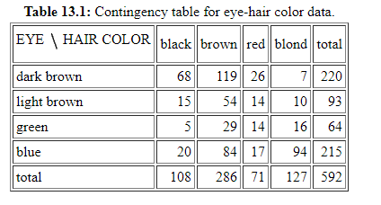
Example
The data set given in Table 13.1 is a contingency table of hair colors (4 categories) and eye colors (4 categories) for 592 women (Lebart, L., Morineau, A., and Piron, M.; 1995).

Slide 3
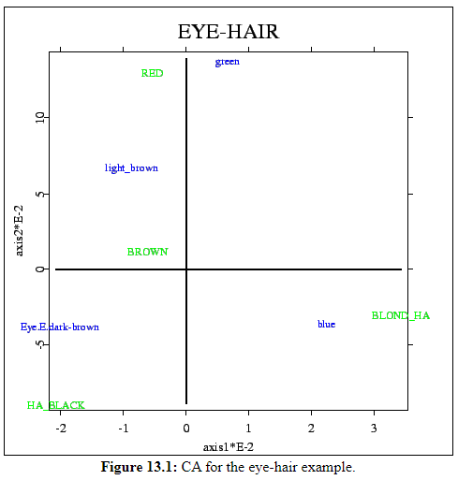
Example

Slide 4
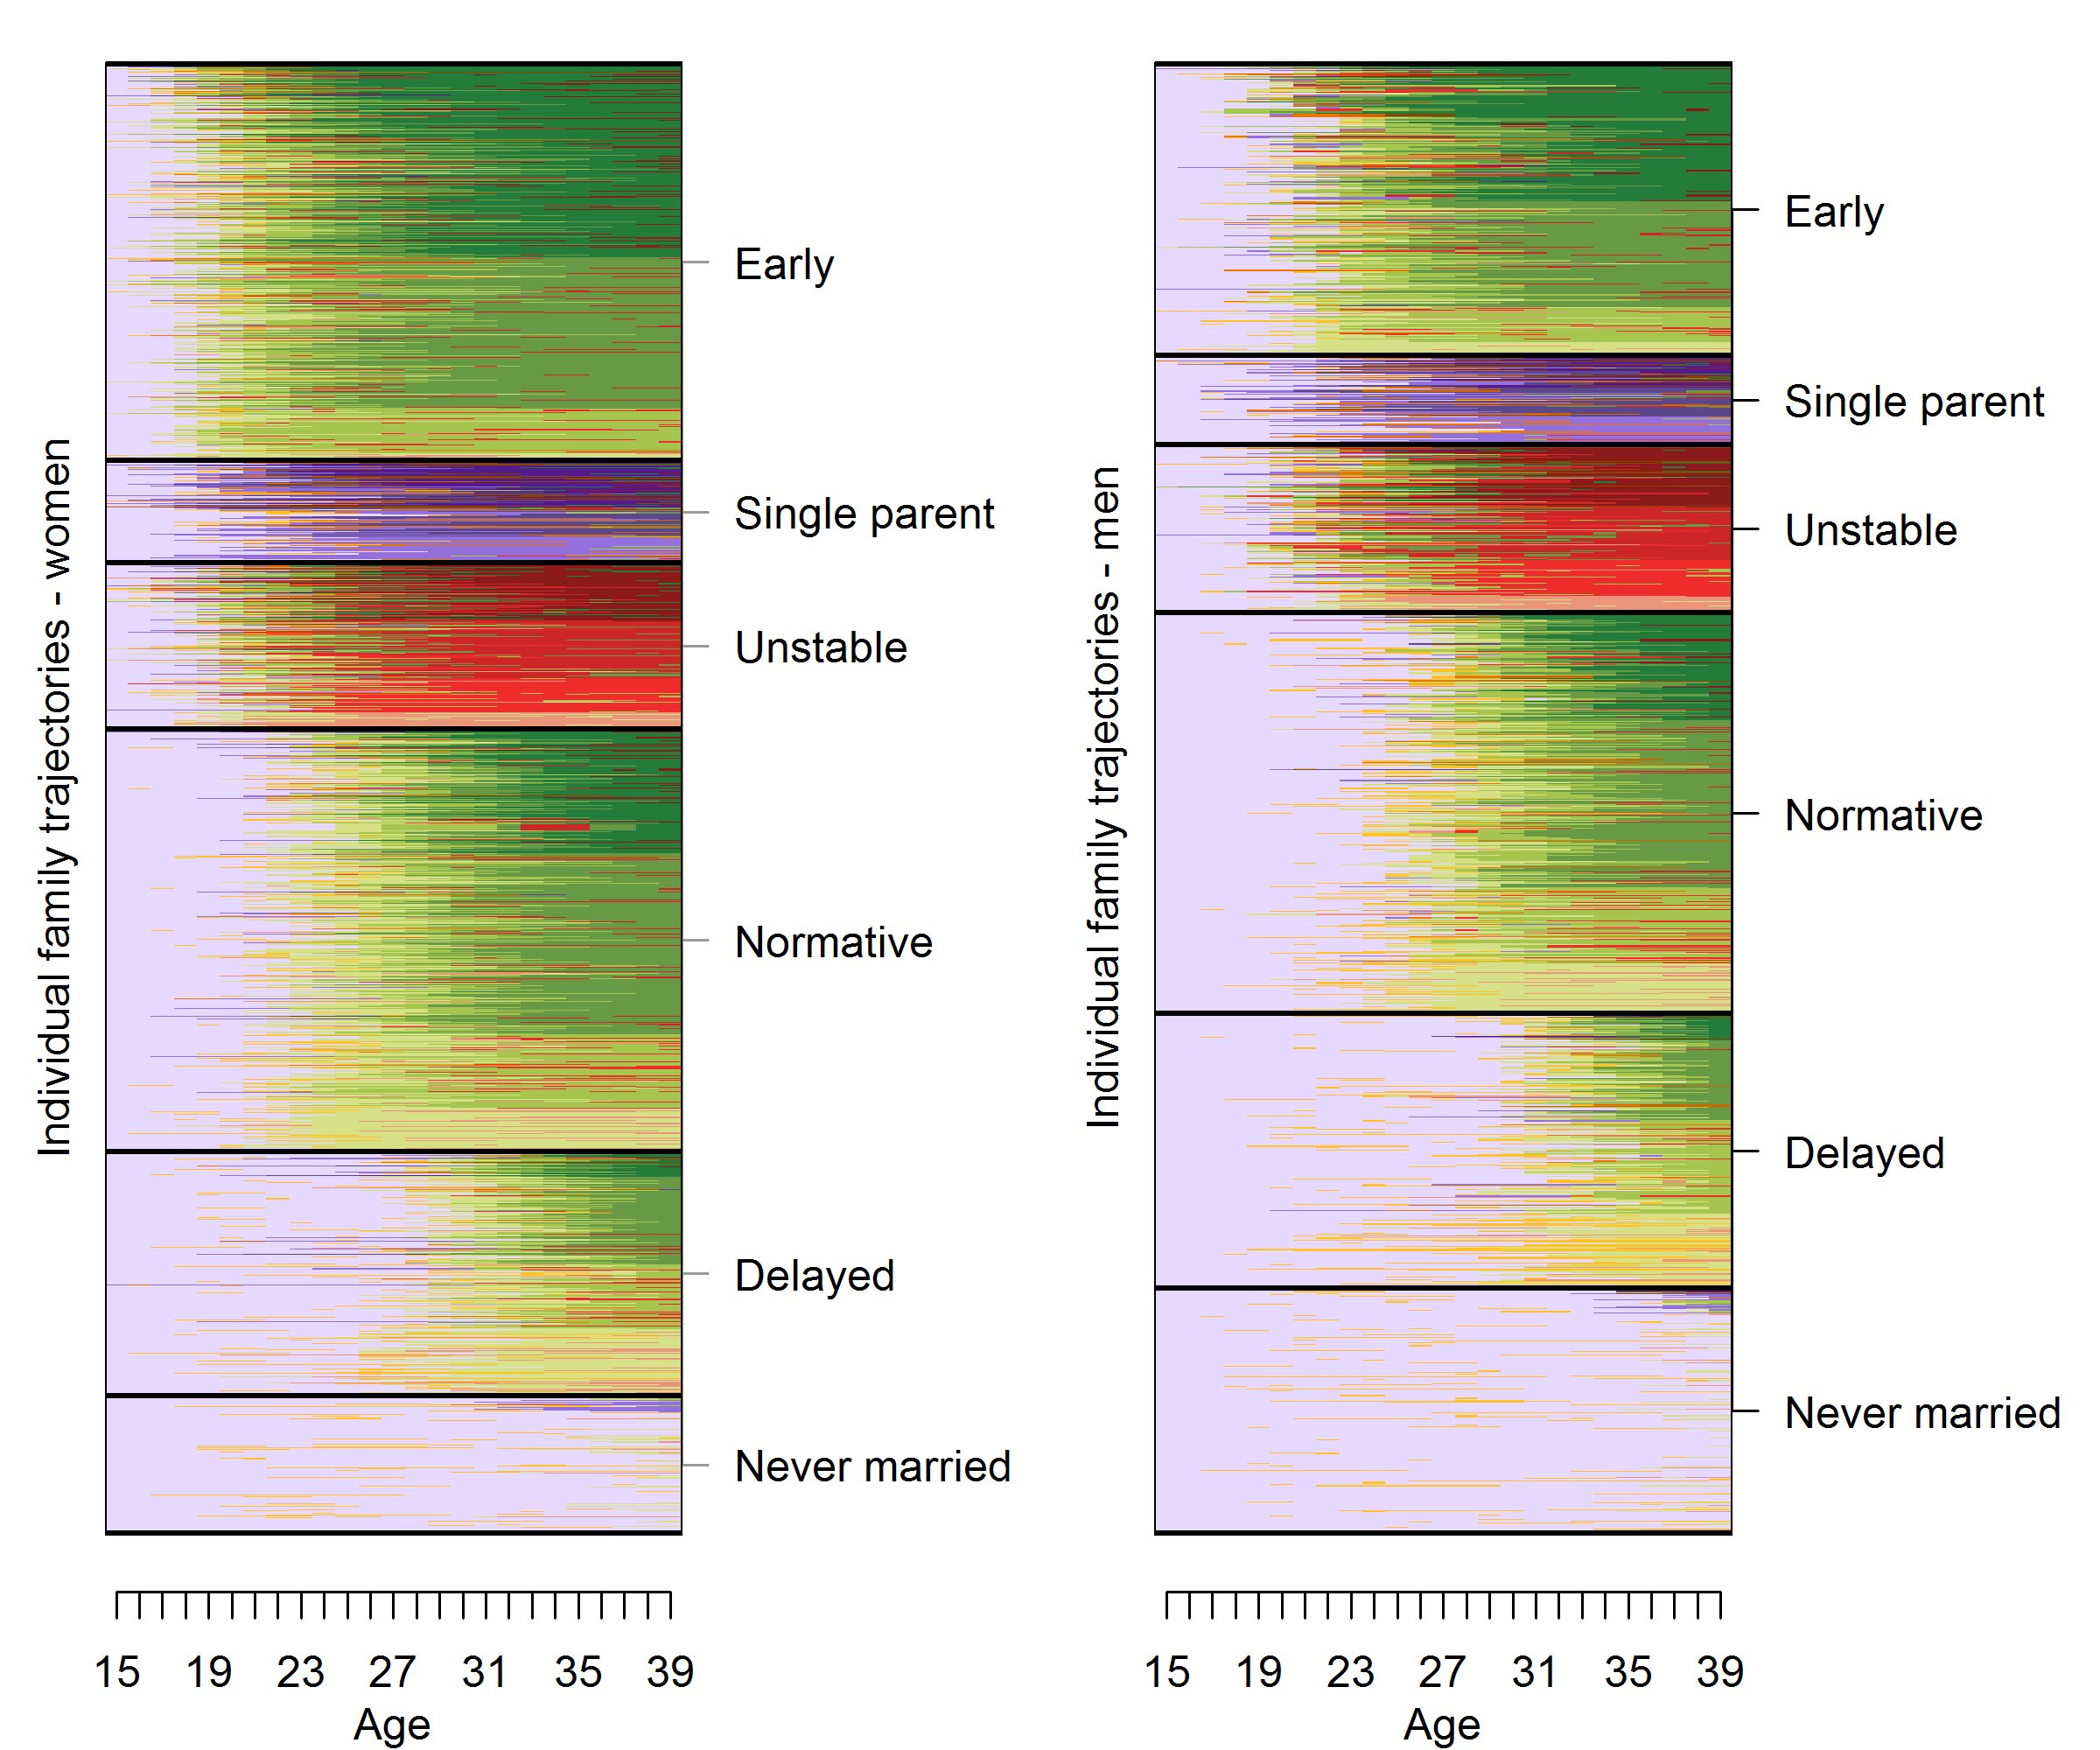
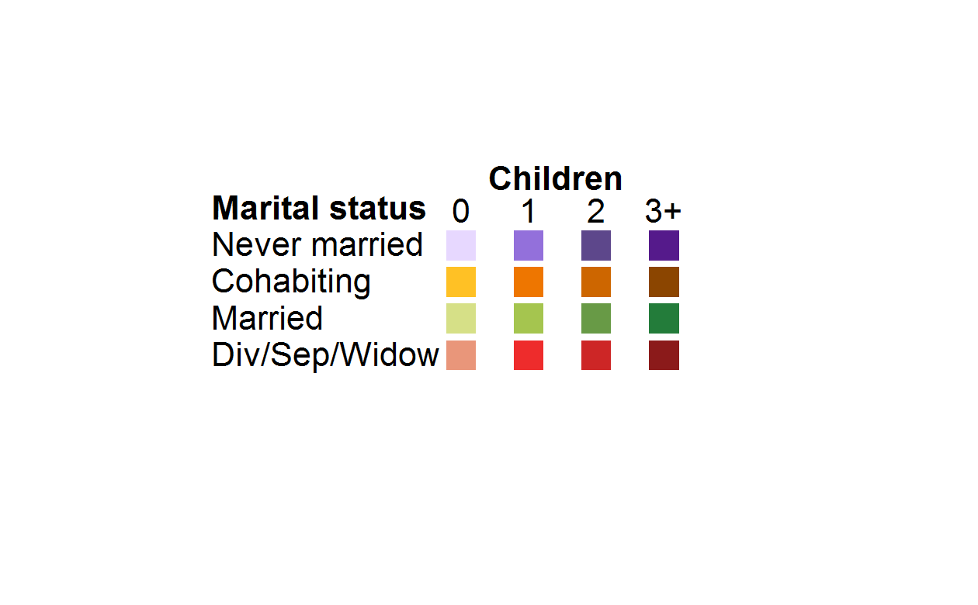
Fertility and partnership trajectories, birth cohorts 1955-1970 – US
National Survey of Family Growth

Slide 5
Are foreign born more less likely to follow certain family paths?
How does this vary by age at migration?
How does this vary by educational attainment?
Are migrant-non-migrant differences larger than differences among US-born?
Strategy: fit a multinomial model predicting the typology of family trajectories using: Race/ethnicity, age at migration and educational attainment.
Controls: birth cohort and religious affiliation

Slide 6
Issues
> round(exp(t(s0$coefficients))/(1+exp(t(s0$coefficients))),2)
ft-01 ft-02 ft-04 ft-05 ft-06
(Intercept) 0.46 0.35 0.78 0.36 0.84
ed3_sesHS 0.33 0.44 0.17 0.14 0.24
ed3_sesSomeC 0.37 0.47 0.14 0.10 0.17
ed3_sesCollege 0.48 0.61 0.04 0.03 0.04
car_migOther 0.41 0.47 0.37 0.40 0.27
car_migBefore age 18 0.19 0.36 0.14 0.16 0.37
car_mig19 to 24 0.13 0.39 0.09 0.06 0.18
car_mig25 to 30 0.19 0.49 0.16 0.24 0.14
car_migAfter age 30 0.25 0.49 0.14 0.22 0.24
rac_demHispanic 0.51 0.56 0.59 0.79 0.67
rac_demNH Black 0.67 0.62 0.63 0.92 0.56
rac_demNH Other 0.61 0.62 0.48 0.86 0.62
ed3_sesHS:car_migOther 0.76 0.46 0.73 0.79 0.72
ed3_sesSomeC:car_migOther 0.67 0.49 0.72 0.67 0.54
ed3_sesCollege:car_migOther 0.70 0.43 0.83 0.79 0.82
ed3_sesHS:car_migBefore age 18 0.89 0.57 0.91 0.92 0.66
ed3_sesSomeC:car_migBefore age 18 0.91 0.64 0.88 0.76 0.75
ed3_sesCollege:car_migBefore age 18 0.87 0.56 0.86 0.51 0.44
ed3_sesHS:car_mig19 to 24 0.78 0.30 0.77 0.66 0.61
ed3_sesSomeC:car_mig19 to 24 0.73 0.37 0.65 0.63 0.72
ed3_sesCollege:car_mig19 to 24 0.56 0.36 0.46 0.72 0.72
ed3_sesHS:car_mig25 to 30 0.52 0.55 0.26 0.15 0.72
ed3_sesSomeC:car_mig25 to 30 0.87 0.65 0.54 0.30 0.64
ed3_sesCollege:car_mig25 to 30 0.59 0.50 0.84 0.70 0.86
ed3_sesHS:car_migAfter age 30 0.24 0.43 0.64 0.65 0.50
ed3_sesSomeC:car_migAfter age 30 0.86 0.73 0.74 0.75 0.65
ed3_sesCollege:car_migAfter age 30 0.77 0.52 0.77 0.59 0.88

Slide 7
Predicted probabilities
ed3_ses car_mig prob.ft.01 prob.ft.02 prob.ft.03 prob.ft.04 prob.ft.05 prob.ft.06
1 No-HS NH white 3.9 5.0 8.9 23.1 11.8 47.3
2 HS NH white 5.2 10.9 24.3 13.4 5.1 41.1
3 SomeC NH white 7.4 14.3 29.0 12.6 4.1 32.5
4 College NH white 14.9 32.8 37.5 4.4 1.6 8.8
5 No-HS Other 4.8 8.0 16.1 24.3 14.2 32.5
6 HS Other 9.8 7.1 20.6 18.1 10.5 34.0
7 SomeC Other 11.5 13.0 31.9 21.2 6.2 16.2
8 College Other 21.3 18.7 32.6 10.8 3.6 13.0
9 No-HS Before age 18 2.0 6.2 19.3 8.2 5.0 59.2
10 HS Before age 18 8.1 6.9 20.0 17.7 9.5 37.8
11 SomeC Before age 18 13.0 10.9 21.7 11.5 1.9 41.0
12 College Before age 18 25.8 25.5 39.5 4.6 0.3 4.2
13 No-HS 19 to 24 2.2 12.1 33.8 9.1 3.1 39.8
14 HS 19 to 24 5.7 5.9 49.0 9.3 1.4 28.7
15 SomeC 19 to 24 5.1 9.1 49.8 4.1 0.8 31.1
16 College 19 to 24 5.0 20.0 65.4 0.7 0.5 8.5
17 No-HS 25 to 30 3.0 15.6 29.2 14.3 12.5 25.5
18 HS 25 to 30 2.4 21.9 42.8 1.6 0.5 30.8
19 SomeC 25 to 30 14.5 32.3 36.7 3.5 0.7 12.2
20 College 25 to 30 5.7 35.0 42.9 5.0 1.4 10.1
21 No-HS After age 30 3.5 13.2 24.1 10.4 8.8 40.0
22 HS After age 30 1.0 15.2 46.3 7.5 5.1 24.9
23 SomeC After age 30 14.4 34.1 26.2 5.5 3.1 16.8
24 College After age 30 15.1 30.8 33.2 2.2 0.6 18.2

Slide 8
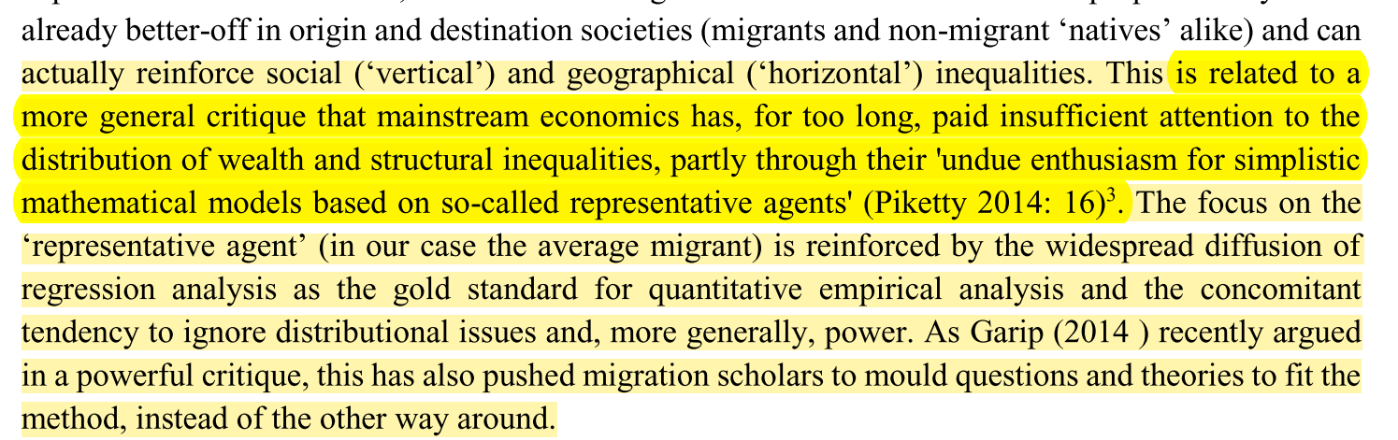
De Haas, Hein (2014) Migration Theory. Quo Vadis?. International Migration Institute

